Slide 1
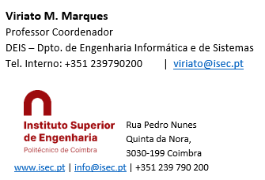
Sistemas de Informação II (LEI) Information Systems (ECS)
Lab Classes
3 – The Data Warehouse

Slide 2
For designing the data warehouse:
Carefully read the problem and clearly understand what we want
Identify measures: what values do we want to know?
Identify dimensions: by which “units” do we want do know the measures?
Hint: in the text, the word “by” generally precedes the dimensions list
Typically there will be a TIME dimension, since we’ll want values by day, week…year
Identify “hierarchies” in the dimensions: generally these correspond to 1:N relationships in the DB
They exist when a measure can be hierarchically aggregated. Example: total sales by city -> state -> country
The TIME dimension has intrinsic hierarchies defined on it: day -> week; day -> month -> year

Slide 3
Design the Dimension Tables
For a STAR schema (more common), specially if there are hierarchies, these tables will be not normalized (i.e. they’ll contain repeated values of some attributes). Example: the country Portugal will appear in line containing a Portuguese city: Lisboa, Porto, Coimbra…
Define the PK of the dimension tables
Design the Fact Table(s)
The Fact Table is composed of its PK followed by the Measure attributes
Its PK is compound, defined by the concatenation of the PKs of the dimension tables
Each attribute of the PK of the Fact Table will be an foreign key for its respective dimension table
For more complex projects, you may need more than 1 Fact Table. It happens when the dimensions of some measures are different, or the update intervals differ, for instance
A Fact table may be defined with a surrogate PK (i.e. ad ID). In this case, its natural PK – the one concatenated above referred – must be unique (i.e. Candidate Key)

Slide 4
The Library Data Warehouse
After applying this procedure and according to the theoretical slides and practical exercises, you should identify:
Measures: the number book borrows and book returns
Dimensions: Reader, Job, Book, Author, Subject, Type (borrow or return book) Day, Week, Month, Year
Hierarchies:
Reader -> Job
Book -> Author
Book -> Subject
Day -> Week
Day -> Month -> Year
The Book dimension has 2 hierarchies
The Time dimension has 2 hierarchies, and there must be 2 independent ways as a month doesn’t have an integer number of weeks
The Type dimension has a single char (E or D – meaning “borrow” or “return”) and so it is a degenerate dimension

Slide 5
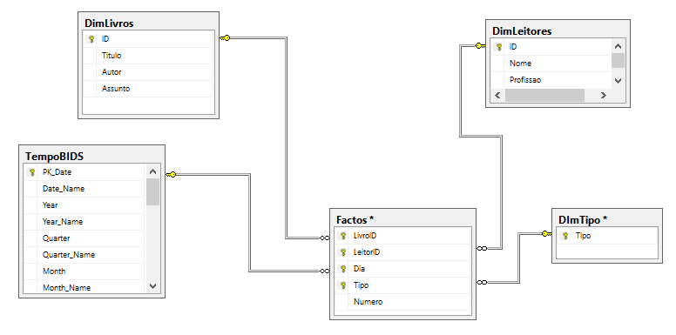
After applying the design procedures of a star data warehouse, you should obtain the following schema:

Slide 6
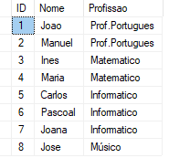
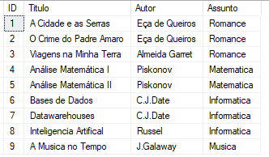
NOTICE:
The table of the dimensions DimLivros and DimLeitores are not normalized, as expected. They will contain repeated data such as job name, Author and Subject name:
The Type dimension table (DimTipo) in fact is not needed, as it is a singe char already presente in the Fact table. However:
We will design it as in fact for BIDS it is much more straightforward to deal with normal dimensions than with the degenerated ones
Even so,, in fact we will not desing it in our physical data warehouse, as we will use this dimension to show, in BIDS; how to create a virtual table that can act as a dimension

Slide 7
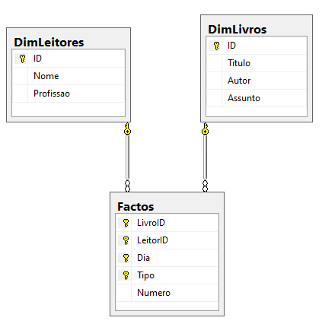
Due to the complexity of the Time dimension (table tempoBIDS):
BIDS has a special tool to create the TIME dimension and all its complex hierarchical structures
So, although it is possible to create manually a time table, we will not do this here: we’ll use the BIDS tool later
So, the final data warehouse for the Library Project, in fact consists of 2 dimension tables and a fact table only:
Enter SSMS (Management Studio, create a new database and design the data warehouse
Keep in mind that the datatypes must be the same of the transacional database.We0ll use nvarchar(50) for strings, and int for the ID’s and numbers such as the measure Numero (number of book borrows or returns)
Create the tables, draw the diagram, specify PKs ena FKs. Close and save.

Slide 8
The Data Warehouse
END

